Slide 1
HTML5
MASTER CLASS
www.raselofficial.com

Slide 2
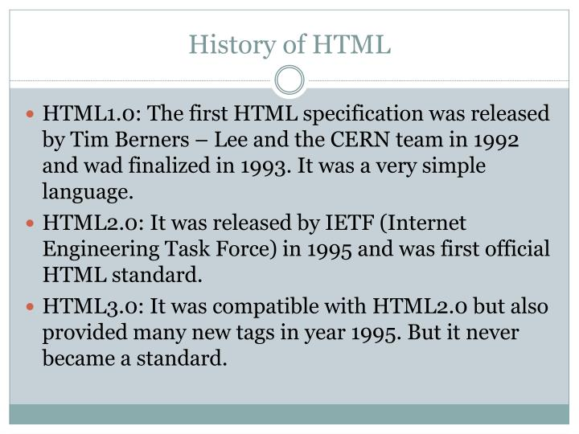
What is HTML & Why is HTML
HTML is the standard markup language for Web pages.
With HTML you can create your own Website

Slide 3





HOW YOU CAN START “HTML CODE”
Code Editor
.html File (index.html)
Code Editor

Slide 4
Basic code of HTML
<!DOCTYPE html>
<html>
<head>
<title>Page Title</title>
</head>
<body>
</body>
</html>

Slide 5
Lets learn some important html tag
Tag
Attributes
<h1> to <h6>
<p>Content</p>
<span> Content </span>
<div>Content</div>
<br>Content</br>
<small></small>
<hr>
<hr size=“10px” color=“red”>
<div style=“width:300px;height:200px;background:red;></div>

Slide 6
HTML LIST
Order List
Unorder List
Nested List
<ol></ol>
<ul></ul>

